Slide 1

Crop Recommendation System
Shraddha Kalaskar

Slide 2
Shraddha Kalaskar
B.Sc (comp.)
Github: https://github.com/kalaskarss
Linkedin : https://www.linkedin.com/in/shraddha-kalaskar-884319243/

Slide 3
Objective
A crop recommendation system predicts the most suitable crops by analyzing soil parameters(such as pH, Nitrogen, Phosphate, and Potassium) and atmospheric conditions(such as rainfall and temperature). This data-driven approach assists farmers in making informed planting decisions.
Develop a machine learning-based System to recommend the best crops to cultivate in a given area based on environmental factors and to predict the potential yield. This system should assist farmers in making informed decisions that will optimize their resources, reduce waste and increase crop yield.

Slide 4

Problem Statement :
Which factors affect crops the most? And how?
Which Crops will yield the highest Production with the least use of resources for specific weather conditions and soil types?

Slide 5
Contents:
Introduction
Problem Statement
Tools(Libraries) Used.
Project Methodology
EDA(Uni , Bi-Variate analysis)
Model Building
Model Evaluation
Model Deployment
Conclusion

Slide 6






Tools (Libraries ) Used.
Python
Numpy
Pandas
Seaborn
Sklearn
Streamlit

Slide 7
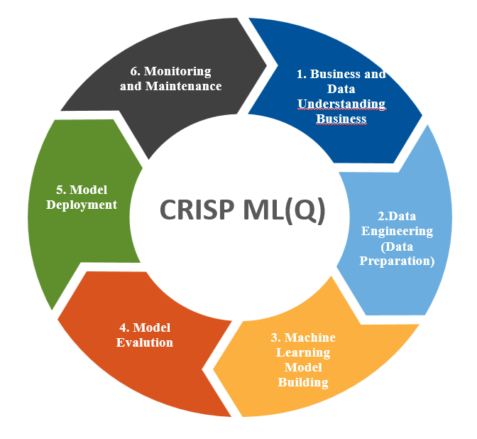
CRISP ML(Q)
Business and Data Understanding
Data Preparation
Model Building
Model Evaluation
Deployment
Model Monitoring and maintenance.

Slide 8
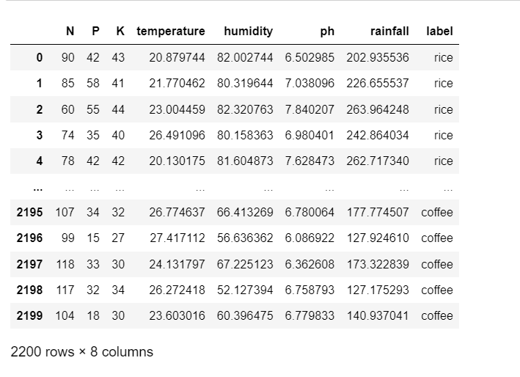
Dataset

Slide 9
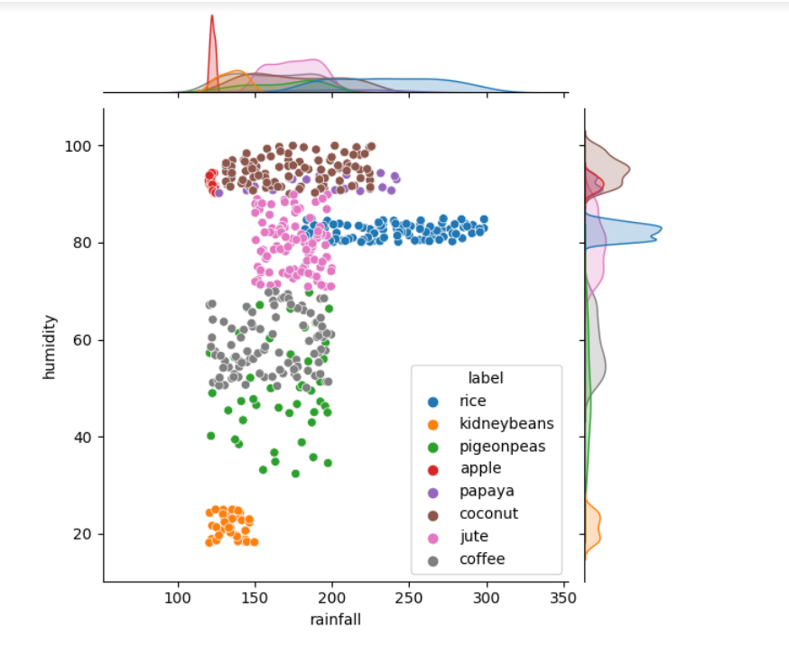
Humidity and Rainfall
🌾Rice needs heavy rainfall (>200 mm) and humidity above 80%. No wonder major rice production in India comes from the East Coasts which has an average of 220 mm of rainfall every year
🌴Coconut is a tropical crop and needs high humidity therefore explaining massive exports from coastal areas around the country.

Slide 10
Model Building
Algorithms | Train Accuracy Score | Test Accuracy Score
KNN | 98.40% | 98.18%
Decision Tree | 100% | 98.86%
Naïve Bayes | 99.54% | 99.31%
Logistic Regression | 97.55% | 97.27%
Support Vector | 98.40% | 98.47%
Random Forest | 100% | 99.54%
Xgboost | 100% | 98.63%
AdaBoost | 19% | 14%
Gradient Boosting | 100% | 97.5%

Slide 11
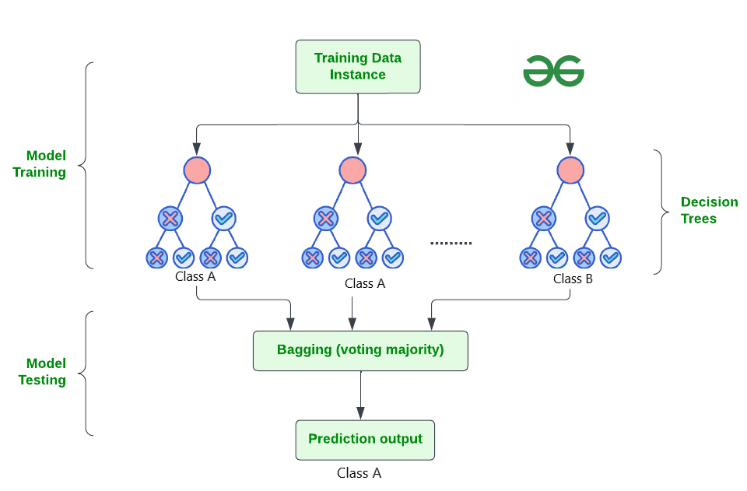
Final Model :
Random Forest Classifier
Advantages:
High Predictive accuracy.
Resistant to overfitting
Drawback:
Memory usage
Overfitting

Slide 12
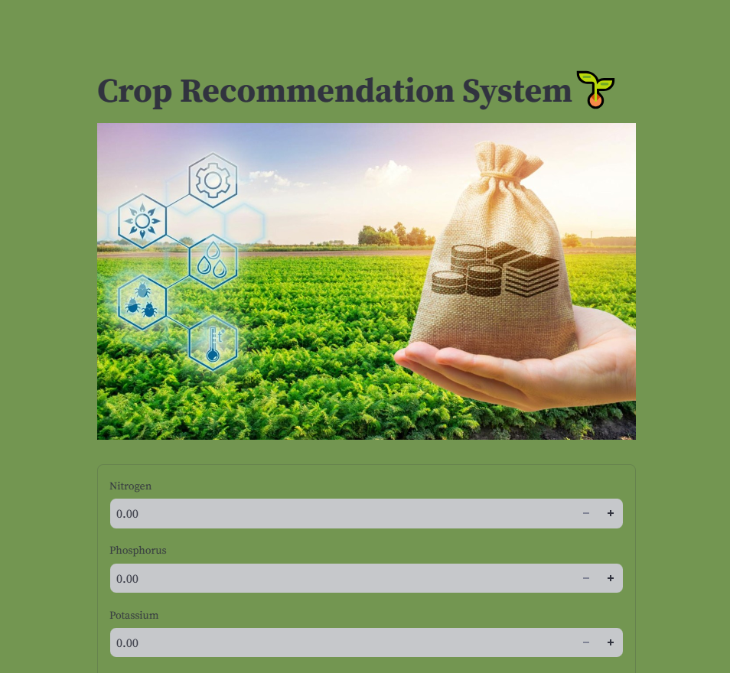
Streamlit App Deployment: User interface

Slide 13
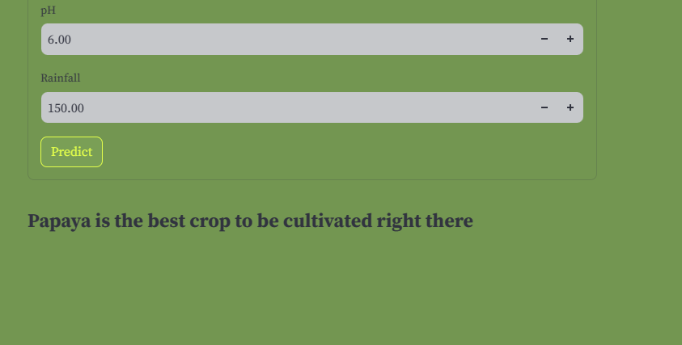
Output

Slide 14
Conclusion
Nitrogen: is crucial for leaf and vegetative growth.
Phosphorus: is essential for energy transfer and photosynthesis.
Potassium: helps in water uptake and resistance to drought and diseases.
The nutritional quality of food is directly influenced by soil composition. Fruits that are rich in nutrients often exhibit stable potassium levels.
Rice needs heavy rainfall(>200m)and a humidity above 80%.
Coconut is a tropical crop and needs high humidity.
Humidity affects plant transpiration rates and can influence the incidence of diseases. High humidity can promote fungal diseases, while very low humidity might stress plants and reduce growth.
Consideration: The specific needs vary by crop, and deficiencies or excesses can significantly impact yield.

Slide 15

THANK YOU

